Slide 1

NAIRR Workshop Series on Cybersecurity, Edge AI, and Autonomous Driving
WPI & Oakland University
Notes:
Good morning everyone,
welcome to the NAIRR Workshop Series on Cybersecurity, Edge AI, and Autonomous Driving.

Slide 2

CARE-AI Team

Slide 3








LIONS Group
Cooper Dean
Zhihao Zhang
Brian Almaguer
Prof. Jun Dai
Haowen Xu
Chao Wang
Tran Ngoc Bao Huynh
Prof. Xiaoyan (Sherry) Sun
Notes:
Before we begin, let me briefly introduce our group.
We are part of the Lions Group at Worcester Polytechnic Institute, led by Prof. Jun Dai and Prof. Xiaoyan Sun.
Our group focuses on research in cybersecurity and AI.
This work is a collaborative effort among members of the group.

Slide 4
2.1 AI for Cybersecurity: Threats and Defenses

Slide 5

Pre-workshop Quiz
https://docs.google.com/forms/d/e/1FAIpQLSfYlz7IJl24VsIMbgRiqswPD1c8iaETFRp5isvF4d1HsJpmQA/viewform?usp=publish-editor

Slide 6
AI-Assisted Intrusion Detection
Notes:
An Intrusion Detection System (IDS) is a security technology designed to monitor network traffic or system activities for malicious activities or policy violations. Unlike a firewall, which acts as a gatekeeper to prevent unauthorized access, an IDS functions like a security camera and alarm system, analyzing internal and external patterns to identify threats that may have already bypassed initial defenses.

Slide 7
Content
What system logs look like
Limitation of traditional method
How machine learning method helps intrusion detection
Hands on experiments

Slide 8
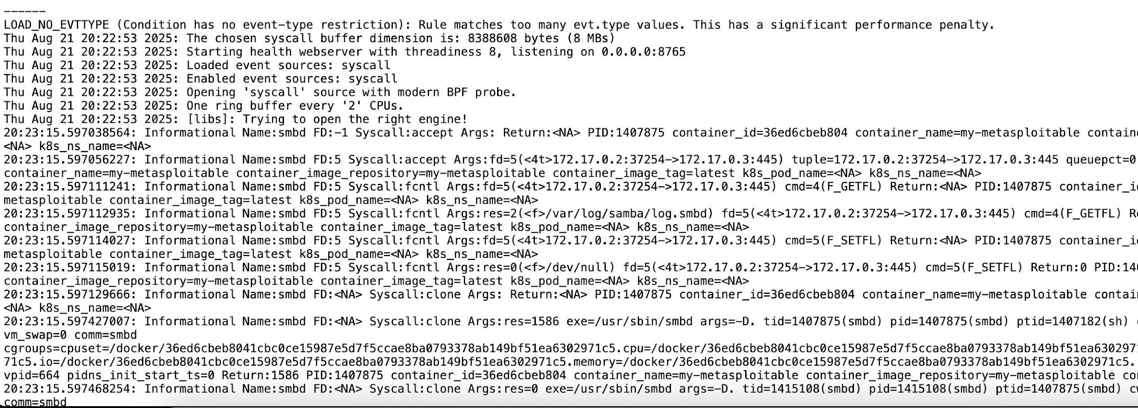
What system logs look like
It can be raw system-level logs
Notes:
"When we talk about monitoring a system, we often see clean dashboards or high-level summaries. But this is what the 'truth' looks like at the ground level. These are raw system-level logs—unstructured, dense, and captured directly from the kernel using tools like Falco or modern BPF probes."
"The first few lines show the environment setup: initializing buffers, loading event sources, and detecting CPUs. But the real action starts in the bottom half. These are records of System Calls (syscalls). Every time a program wants to talk to the network, open a file, or create a new process, it must ask the kernel. That request is what we see captured here."
3. Deep Dive: Anatomy of a Log Entry (The accept Example)
"Let’s look at the line starting with 20:23:15... Syscall:accept. To a human, it looks like alphabet soup. To a security or DevOps engineer, it’s a detailed story. Let’s break down what one single log entry tells us:"
A. The 'When' and 'Who' (Context)
Timestamp: 20:23:15.597... – Precise down to the microsecond. In high-speed systems, this precision is vital for correlating events.
Process Name: Name:smbd – This tells us the Samba daemon (used for file sharing) is the one performing the action.
Process ID (PID): PID:1407875 – This allows us to track this exact instance of the program across the entire system.
B. The 'What' (The Action)
Syscall Type: Syscall:accept – This is the 'verb' of the sentence. The program is 'accepting' an incoming network connection request.
File Descriptor (FD): fd=5 – The kernel has assigned index 5 to this specific connection for the process to use.
C. The 'Where' (Network Detail)
Connection Tuple: 172.17.0.2:37254 -> 172.17.0.3:445
Here, we see the source IP and port connecting to the destination. Since it's port 445, we know someone is trying to access a Windows-style file share (SMB).
D. The 'Environment' (Cloud-Native Metadata)
Container Identity: container_name=my-metasploitable
Container ID: 36ed6cbeb804...
This is the most critical part for modern infrastructure. The log doesn't just say 'a process did this'; it tells us exactly which container it happened in. Given the name 'metasploitable', we can infer this log is likely from a security lab or a penetration testing exercise.

Slide 9
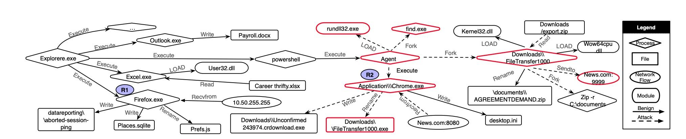
What system logs look like
It can be provenanced-based logs
Notes:
"While raw text logs tell us what happened, provenance-based logs show us why it happened. Instead of reading thousands of lines of text, we represent system activity as a causality graph. This allows us to see the 'family tree' of every action in the system."
2. Decoding the Graph
"As you can see in the Legend, we use different shapes and colors to categorize the data:
Diamonds are Processes, Rectangles are Files, and Ovals are Network Flow.
Solid lines represent benign, everyday activity (shown in blue), like Outlook writing a Word document.
Dashed lines (highlighted in red) represent an attack path."
3. Identifying the Attack Chain
"The power of this visualization is how easily it exposes a threat. If we follow the red path, we see a clear story:
An infected Chrome.exe executes a malicious Agent.
This Agent Forks a tool called find.exe to scout the system.
Finally, it bundles data into a ZIP file and uses Sendto to exfiltrate that data to an external server: News.com on port 9999."

Slide 10
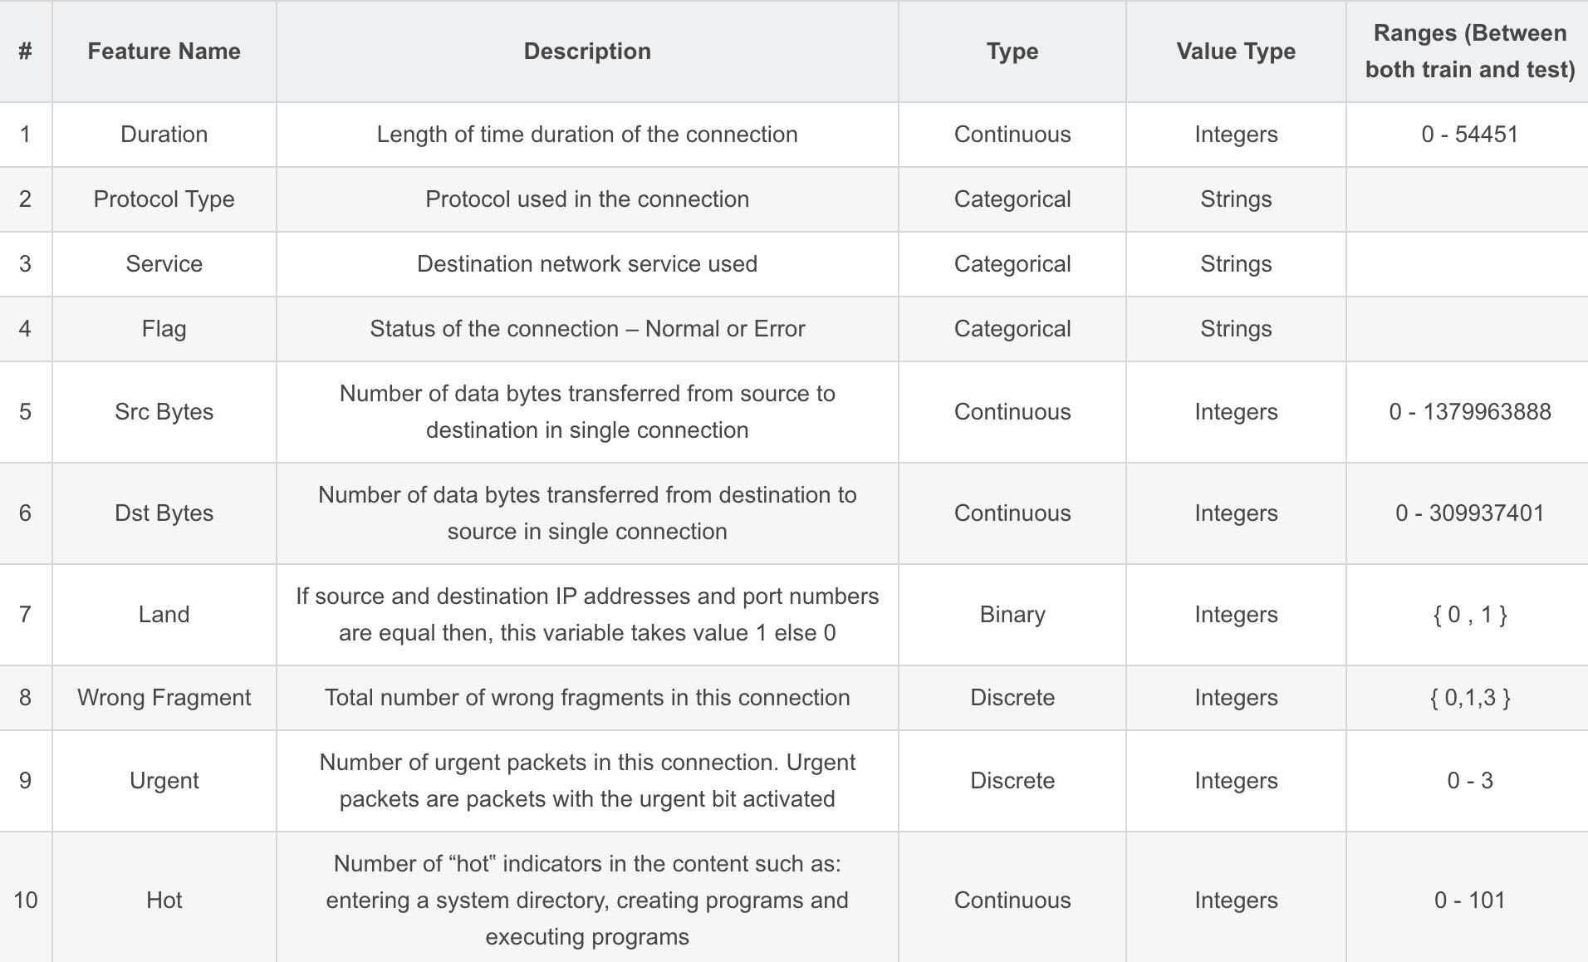
What system logs look like
It can also be manually labeled
Notes:
"We’ve looked at raw text and visual graphs, but if we want to build a Machine Learning model to detect threats, we need to transform that data into a structured format. This is where manually labeled feature engineering comes in."
2. Structuring the Data
"As shown in this table, we take specific attributes of a connection and turn them into quantifiable variables. This process is the bridge between raw system activity and an AI’s ability to 'learn' what a 'normal' versus an 'attack' state looks like."
3. Key Feature Examples
"Let’s look at a few specific rows:
Duration & Bytes (Rows 1, 5, 6): These are Continuous features. They track the length of time and the volume of data transferred. A sudden spike in 'Src Bytes' could indicate data exfiltration.
Protocol & Service (Rows 2, 3): These are Categorical strings, like 'TCP' or 'HTTP', which help the model understand the context of the communication.
The 'Land' Feature (Row 7): This is a Binary indicator. It checks if the source and destination IP/Ports are the same—a classic sign of a 'Land Attack' designed to crash a system.
The 'Hot' Indicator (Row 10): This tracks system events like entering a sensitive directory or executing programs, giving the model a behavioral score."

Slide 11
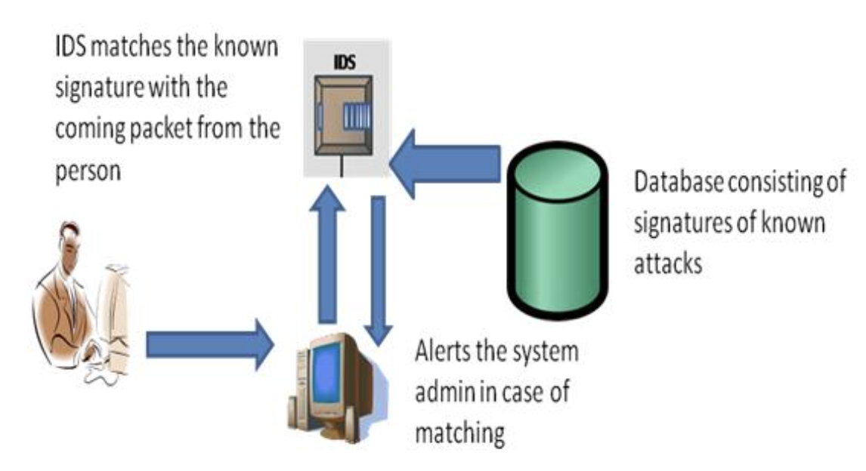
Limitaion of traditional method
Pattern based, signature based
Rely on manually defined attack signatures
→ Only effective for known attacks
Easily evaded by attack variants or obfuscation
→ Small changes in payload can bypass detection
High maintenance cost for rule updates
→ Requires continuous expert intervention
Poor generalization to new systems or environments
→ Rules do not transfer well across deployments
Notes:
Signature-based Intrusion Detection System: This system works on the principle of matching. The data is analyzed and compared with the signature of known attacks. In case of any matching, an alert is issued. An advantage of this system is it has more accuracy and standard alarms understood by the user.

Slide 12
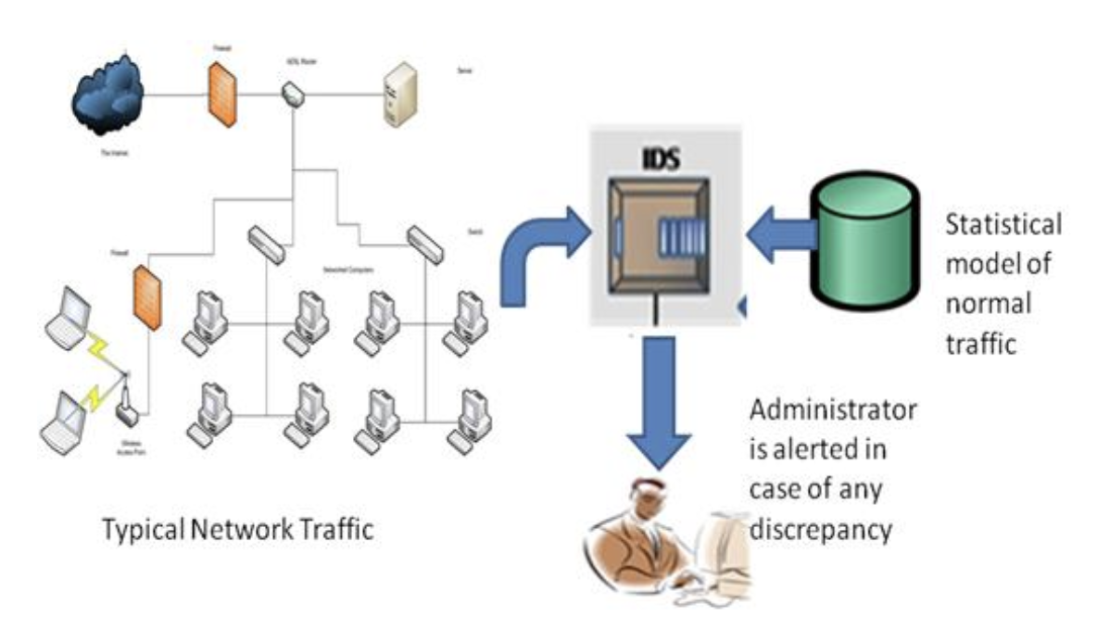
Limitaion of traditional method
Anomaly based
Depend on an accurate model of “normal behavior”
→ Hard to define in real-world systems
High false positive rate
→ Rare but benign behaviors are flagged as attacks
Sensitive to system and workload changes
→ Updates and configuration changes break assumptions
Thresholds are often manually tuned
→ Unstable and environment-specific
Notes:
Anomaly-based Intrusion Detection System: It consists of a statistical model of normal network traffic which consists of the bandwidth used, the protocols defined for the traffic, the ports, and devices that are part of the network. It regularly monitors the network traffic and compares it with the statistical model. In case of any anomaly or discrepancy, the administrator is alerted. An advantage of this system is it can detect new and unique attacks.

Slide 13
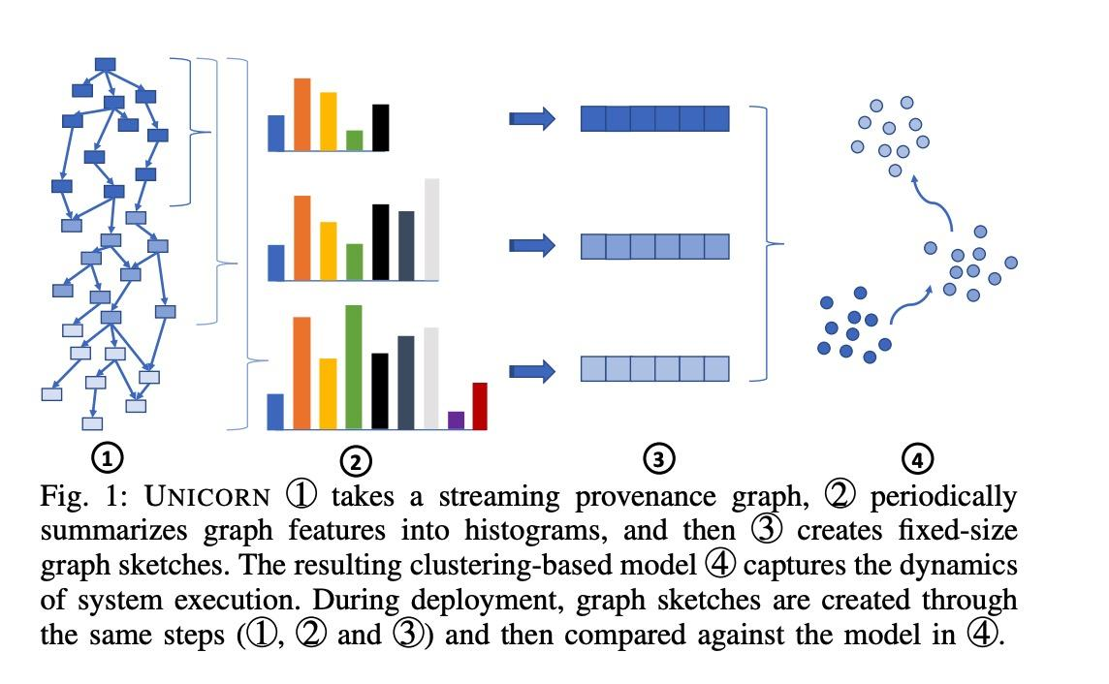
How machine learning method helps IDS
Automatically learn patterns from data
→ Reduce reliance on hand-crafted rules
Handle high-dimensional and multi-source logs
→ System calls, processes, networks, provenance, etc.
Better generalization to unseen attacks
→ Detect behavior patterns rather than exact signatures
Support diverse models and representations
→ ML (LR, RF) and DL (CNN, GNN for sequences and graphs)
Notes:
1. Introduction: The Need for Automation
"We’ve seen how rich system logs can be, but analyzing them manually is impossible at scale. This is where Machine Learning changes the game. Instead of relying on humans to write thousands of hard-coded rules, we let the system automatically learn patterns from the data itself."
2. Case Study: The UNICORN Framework
"Look at the diagram on the left, which illustrates a framework called UNICORN. It follows a four-step pipeline to turn behavior into intelligence:
Graph Construction: It starts with a streaming provenance graph, capturing system execution in real-time.
Feature Summarization: It periodically breaks the graph into histograms to capture local behaviors.
Graph Sketching: These histograms are compressed into fixed-size 'sketches'—think of this as a digital fingerprint of the system's current state.
Clustering: Finally, these fingerprints are clustered. 'Normal' behavior stays in one group, while 'Attacks' appear as outliers that don't fit the pattern."
3. Key Advantages of the ML Approach
"Why is this approach superior to traditional methods?
Handling Complexity: It can process high-dimensional data—syscalls, network flows, and provenance—all at once.
Generalization: Traditional IDS looks for 'signatures' (exact matches of known viruses). ML looks for behavioral patterns. This means it can detect 'Zero-day' attacks—threats it has never seen before—simply because they behave differently than normal operations.
Model Diversity: We can use everything from classic models like Random Forest (RF) to cutting-edge Deep Learning like Graph Neural Networks (GNN) to analyze these complex relationships."

Slide 14
Hands on experiments
Task1: explore nsl-kdd datasets
Task2: feature extraction
-- how to handle multiple features labeled
Task3: model choosing
-- machine learning: Logistic Regression, Decision Tree, Random Forest, ...
-- deep learning: CNN, GNN, ...

Slide 15
Logistic Regression Fundamentals
Core Concept
A linear model used for binary classification that predicts the probability of a data point belonging to a specific class.
Key Points
Feature Independence:
Assumes classes can be separated by a straight line (or hyperplane).
Notes:
"Think of Logistic Regression as a security guard with a simple scorecard. For every person entering, he checks a few things: 'Are they running?' (+10 points) 'Are they wearing a mask?' (+40 points). He adds it all up into a final score from 0 to 100. If your score is over 50, you’re flagged as a threat. It’s fast, simple, and direct."

Slide 16
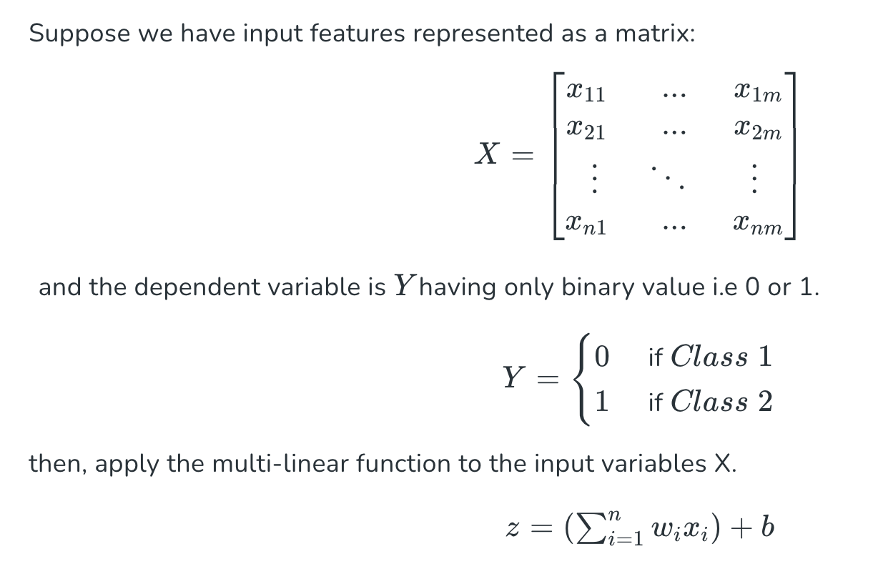
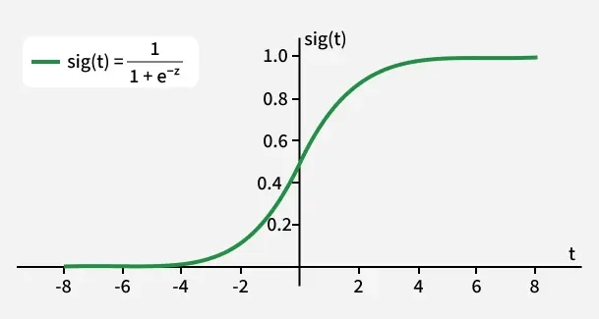
Logistic Regression
Notes:
1. The Input Matrix ($X$)
"To understand these results, we must look at the data structure. The matrix $X$ represents our input features—the 'raw system data' we discussed earlier. In this specific model run, $X$ contains thousands of observations. Each row is a system event, and each column is a feature that the model uses to calculate the value of $z$."
2. Predicting the Outcome ($Y$)
"Our target matrix $Y$ is binary. As shown in the confusion matrix:
Class 0 represents benign activity.
Class 1 represents an attack.
The Sigmoid function 'squashes' our linear calculations into a probability. If that probability is closer to 1, the model predicts Class 1.""Don't let the math scare you. This formula is just a 'Probability Converter'."
The Input ($z$): "The $z$ is the total 'Suspicion Score' we calculated from the network traffic. Maybe it's 10 points, maybe it's 100."
The Magic Box (The Formula): "This formula acts like a funnel. No matter how high or low the score is, it crushes it into a range between 0 and 1."
The Result ($P$): "If the result is 0.9, it means there's a 90% chance this is an attack. If it's 0.1, it's probably just a regular user."
3. Evaluating the Confusion Matrix
"Now, let’s look at the Testing Confusion Matrix to see the actual counts:
True Negatives (Top-Left, 12,015): The model correctly identified these as safe.
True Positives (Bottom-Right, 10,424): The model successfully caught these attacks.
The Errors: The matrix also reveals 1,354 False Positives (crying wolf) and 1,400 False Negatives (missing the attack). These specific numbers are what drive our Precision and Recall metrics."
4. Analyzing the Performance Metrics
"Looking at the text output at the top, the model achieves an Accuracy of 89.07% on the test set.
Precision (88.50%): When the model flags an attack, it's right nearly 89% of the time.
Recall (88.16%): The model identifies 88% of all actual attacks present in the data.
Consistency: Notice how the training and testing metrics are almost identical (89.11% vs 89.07%). This is a great sign—it means our matrix $X$ was well-structured, and the model has generalized well to new data rather than just memorizing the training set."

Slide 17
Naive Bayes Algorithm Fundamentals
Core Concept
Bayes' Theorem
Naive Bayes is a probabilistic classifier based on Bayes' Theorem with an assumption of independence between features.
P(A|B) = [P(B|A)P(A)] / P(B)
Key Points
Feature Independence: Assumes every feature is independent of others.
Gaussian Variant: Used when features follow a normal distribution (Bell Curve).

Slide 18
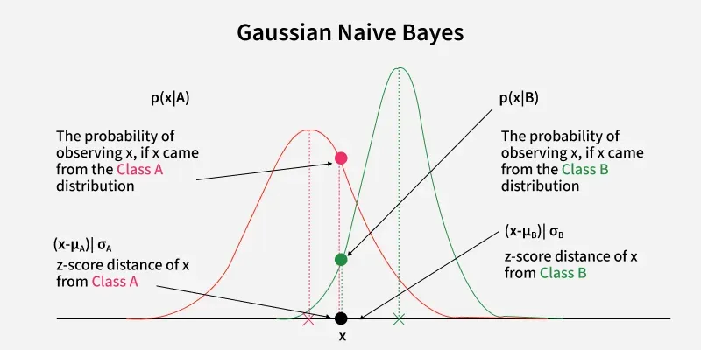
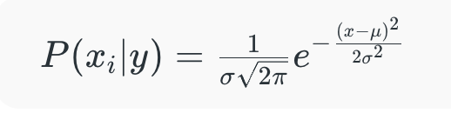
Gaussian Naive Bayes
Notes:
"While Logistic Regression uses a sigmoid curve to separate classes, Gaussian Naive Bayes takes a different approach. It assumes that the data for each class—whether it's benign system traffic or a malicious attack—follows a Normal Distribution, commonly known as the Bell Curve."
2. Visualizing the Decision Process
"Look at the graph in the center. We have two distributions representing two classes:
Class A (Red Curve): Let's say this represents 'Normal' behavior.
Class B (Green Curve): This represents 'Attack' behavior.
The Data Point ($x$): The black dot on the x-axis represents a new system event we just observed."
3. Probability Density and Z-Scores
"To decide which class $x$ belongs to, the model calculates the likelihood of observing that value in both distributions:
Red Dot ($p(x|A)$): This is the probability that $x$ came from the 'Normal' distribution.
Green Dot ($p(x|B)$): This is the probability that $x$ came from the 'Attack' distribution. In this specific example, the red dot is higher than the green dot, so the model would classify this event as Class A (Normal)."
4. The Math: Probability Density Function
"On the right, we see the formula that powers this logic:
$$P(x_i | y) = \frac{1}{\sigma \sqrt{2\pi}} e^{ -\frac{(x-\mu)^2}{2\sigma^2} }$$
This is the Gaussian Probability Density Function. It uses two key parameters:
$\mu$ (Mean): The center of the curve.
$\sigma$ (Standard Deviation): The spread or width of the curve. By calculating the 'Z-score distance'—how many standard deviations $x$ is from the mean—the model determines which 'neighborhood' the data point most likely belongs to."

Slide 19
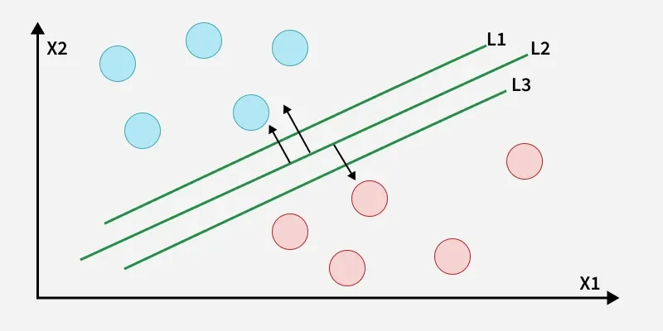
Support Vector Machine Fundamentals
Core Concept
Finds the optimal hyperplane that maximizes the margin between two classes of data.
Key Points
Support Vectors: The model only relies on the most 'difficult' data points (those closest to the boundary) rather than the whole dataset.
Notes:
"SVM is a perfectionist. It doesn't just want to separate the 'Good Guys' from the 'Bad Guys'; it wants to build the widest possible empty space between them. By creating this 'safety buffer,' SVM ensures that even if a hacker changes their behavior slightly, they still won't be able to sneak across that wide gap unnoticed."

Slide 20
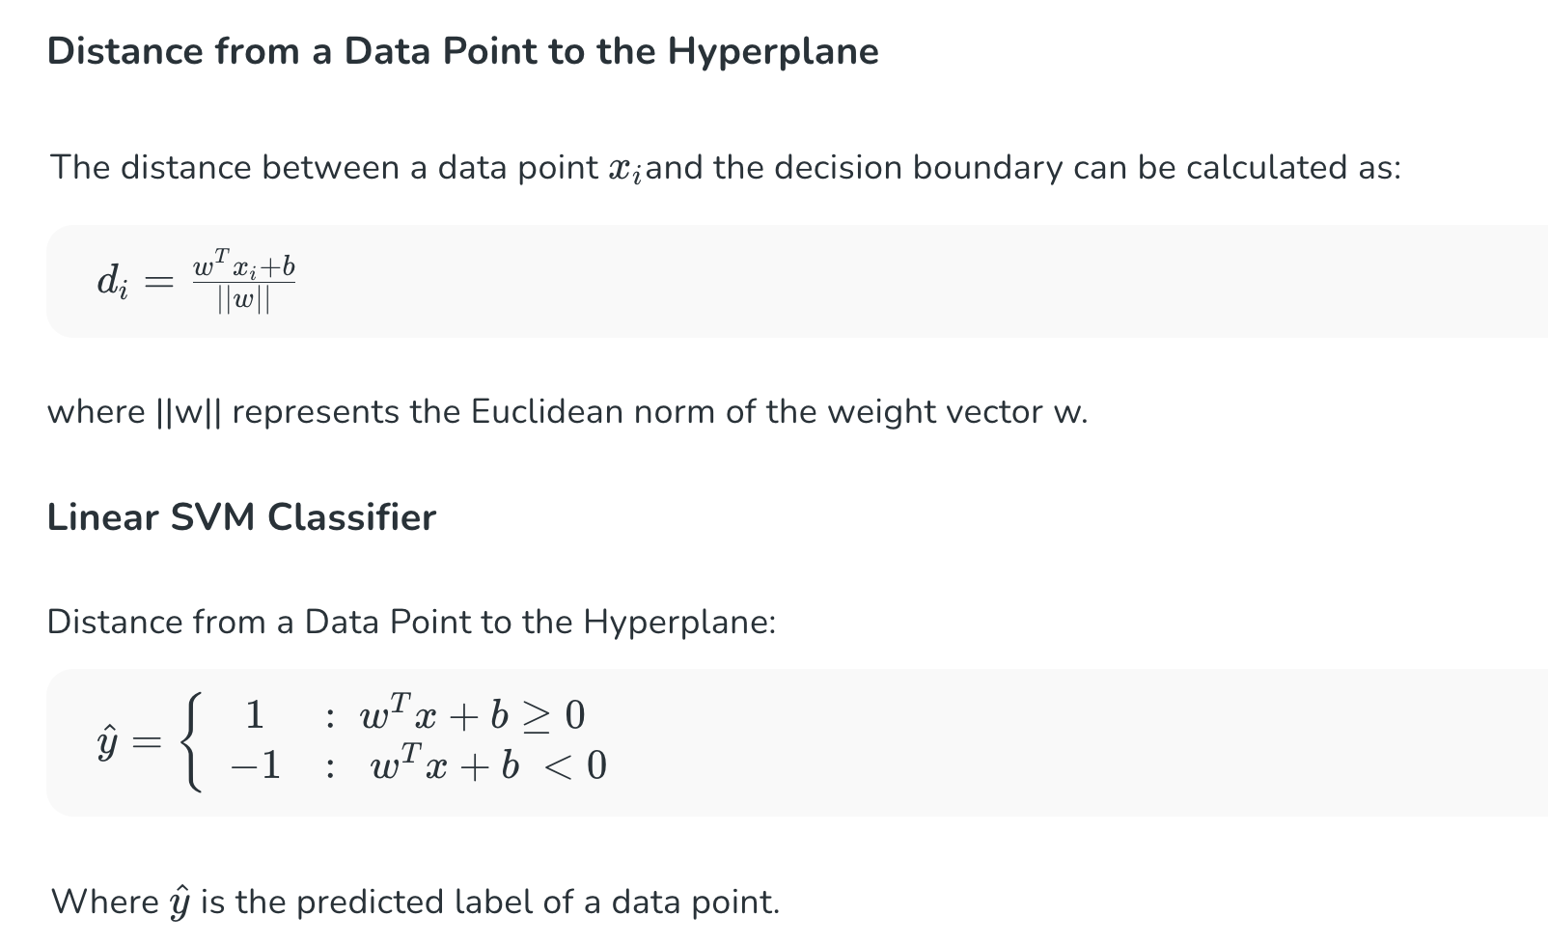
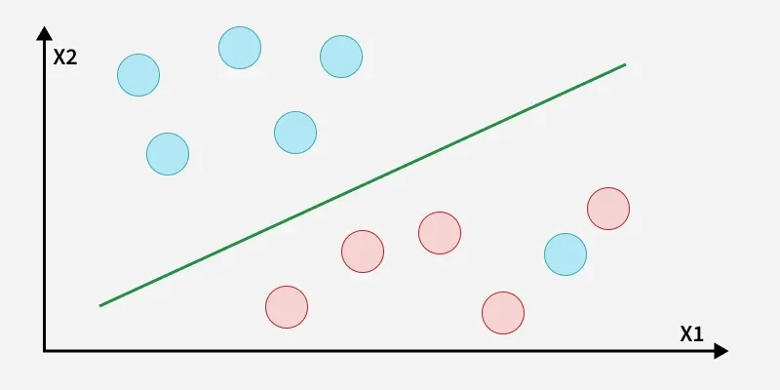
Support Vector Machine (SVM)
Notes:
"We’ve discussed probabilistic models like Naive Bayes, but Support Vector Machines (SVM) take a more geometric approach. Imagine our system logs plotted on a map. SVM’s goal is to find the perfect 'border'—a Hyperplane—that separates normal behavior from malicious attacks with as much breathing room as possible."
2. The Geometry of Classification
"Looking at the graph on the left, we have two classes of data points. The green line is our decision boundary. To make this boundary as robust as possible, we calculate the distance from each data point $x_i$ to that line.
As shown in the first formula:
$$d_i = \frac{w^T x_i + b}{\|w\|}$$
Here, $w$ represents the weight vector (the orientation of the line), $b$ is the bias (its position), and the denominator is the Euclidean norm used to normalize the distance. SVM tries to maximize the 'margin'—the space between the closest points of each class and the boundary."
3. The Linear SVM Classifier
"Once the model is trained and the hyperplane is set, classifying new data becomes a simple mathematical check. Look at the Linear SVM Classifier logic at the bottom:
If the result of $w^T x + b$ is greater than or equal to 0, the model predicts a label of 1 (e.g., an Attack).
If the result is less than 0, it predicts -1 (e.g., Benign). This predicted label, $\hat{y}$, tells us instantly whether a new log entry should trigger an alert."
4. Why SVM for Intrusion Detection?
"The real strength of SVM lies in its 'Support Vectors'—the specific data points closest to the boundary. Because the model only cares about these critical points, it is highly effective in high-dimensional spaces (where logs have many features) and is less likely to be distracted by outliers or noise in the data."

Slide 21
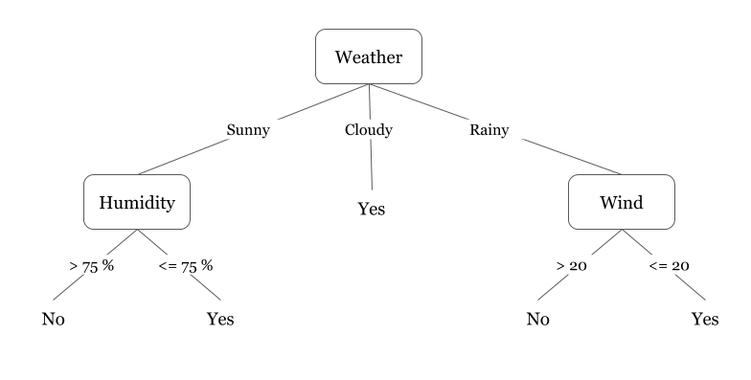
Decision Tree Fundamentals
Core Concept
A flow-chart-like structure where each internal node represents a 'test' on an attribute, and each leaf node represents a class label.
Key Points
Interpretability: Unlike 'Black Box' models, Decision Trees are easy to visualize as a set of nested 'IF-THEN' rules.
Greedy Approach: Makes the best local split at each step, which can lead to overfitting if the tree grows too deep.
Notes:
"A Decision Tree works like a simple flowchart. It asks one question at a time: 'Is the file size big?' If Yes, 'Is it from an unknown IP?' If Yes, then 'Alert!'. Security teams love this because it’s transparent. If it catches a virus, you can look back at the 'map' and see exactly which questions led to that conclusion."

Slide 22
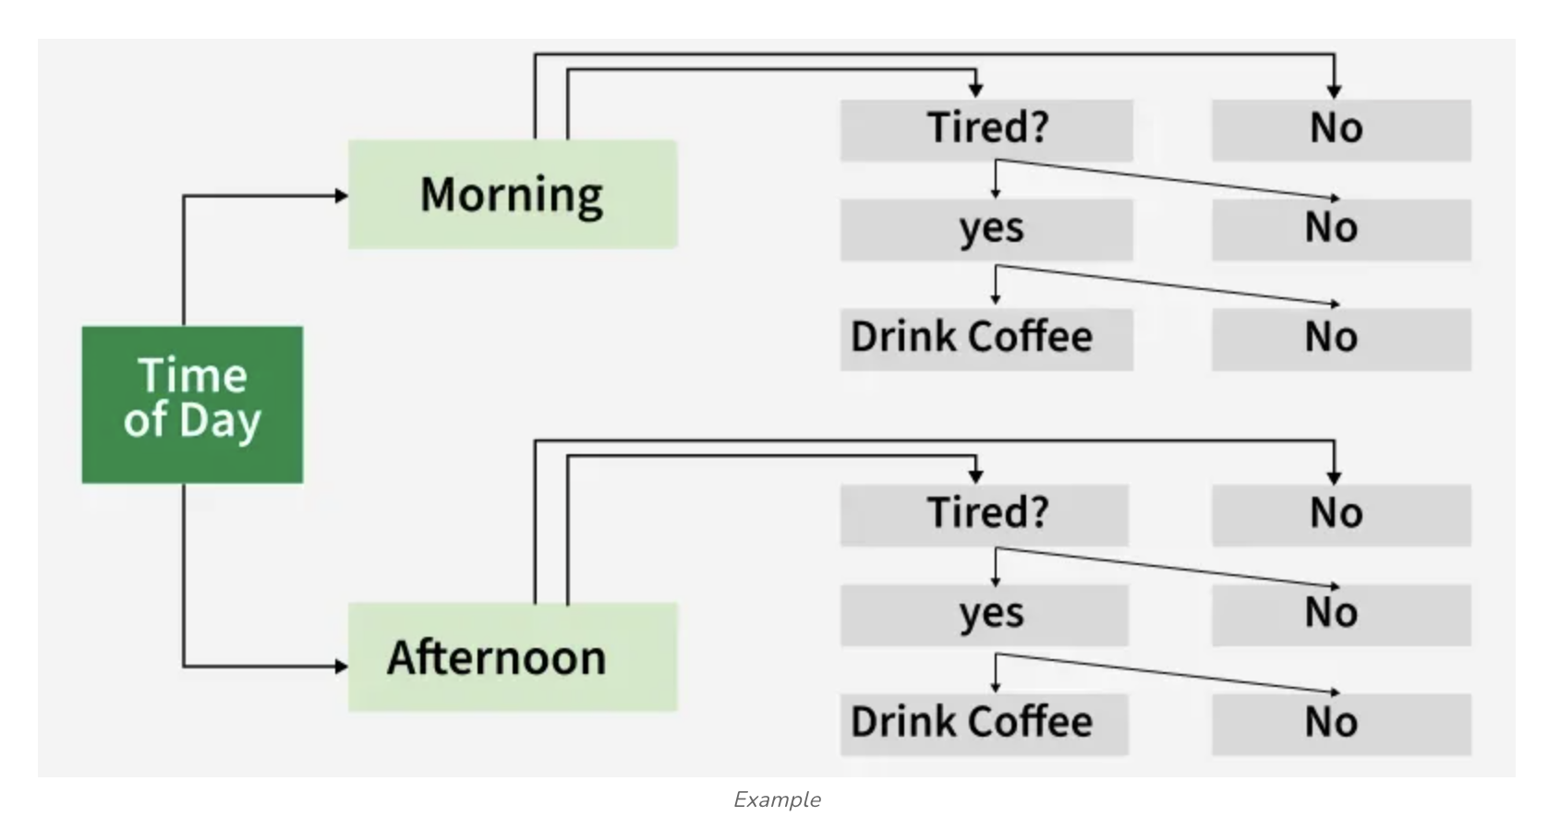
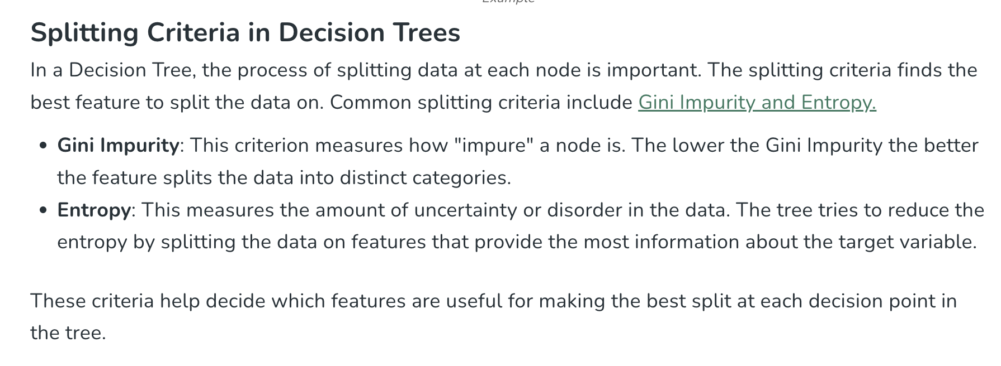
Decision Tree
Notes:
1. The Logic of the Tree
"We previously discussed the Decision Tree. As you can see in the diagram, it works by asking a series of hierarchical questions. For an Intrusion Detection System (IDS), these questions might be: 'Is the user logged in?' or 'Is this a guest login?' By following these branches, we eventually reach a 'leaf' that classifies the event as either Benign or an Attack."
2. Measuring Importance
"But which questions are the most important? Not all system features are created equal. Look at the Feature Importances bar chart for the Decision Tree.
We calculate this by looking at which features reduce the most 'Entropy' or 'Gini Impurity' across the tree.
In this specific model, is_host_login and is_guest_login are the dominant features. This tells us that in our dataset, the login status is the most critical indicator of whether an activity is malicious."

Slide 23
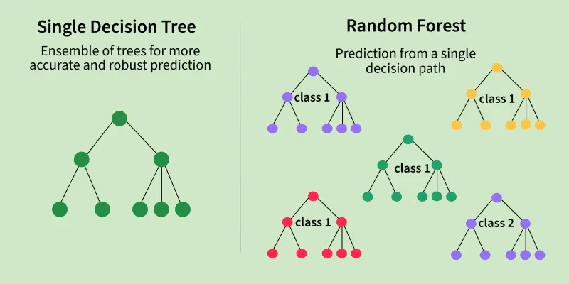
Random Forest Fundamentals
Core Concept
Core Concept: An Ensemble Learning method that constructs a multitude of decision trees during training and outputs the majority vote.
Key Points
Diversity over Depth: By combining many 'weak' trees, the forest becomes a 'strong' learner.
Feature Importance: RF can automatically rank which network features (e.g., protocol type vs. duration) are most useful for detection.
Notes:
"One person can be wrong, but a crowd is usually right. Random Forest is just a group of 100 Decision Trees. Each tree looks at a different part of the data. At the end, they all vote. If 80 trees say 'Attack' and 20 say 'Normal,' the system sounds the alarm. This makes it incredibly reliable because one 'confused' tree can't ruin the whole result."

Slide 24
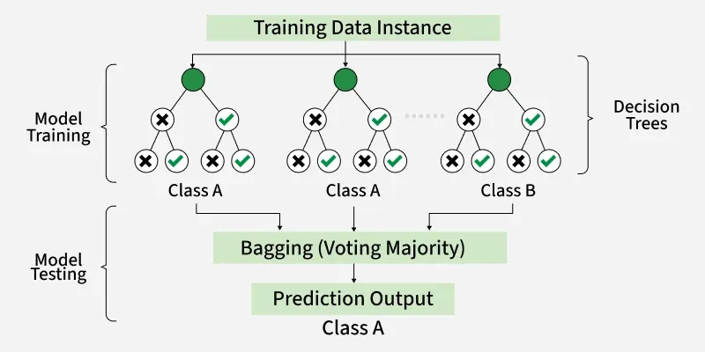
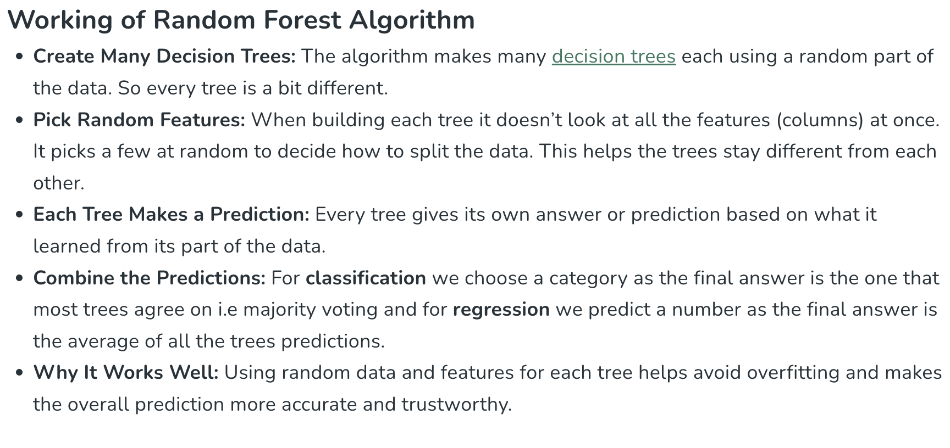
Random Forest
Notes:
Part 2: Random Forest – Strength in Numbers
1. From a Tree to a Forest
"A single Decision Tree is easy to understand, but it can be 'brittle'—it might overfit to noise in the data. To fix this, we use a Random Forest. Think of this as a Democratic Committee of Trees. Instead of one tree making the call, the algorithm creates hundreds of different trees."
2. The Secret Sauce: Randomness
"As shown in the 'Working of Random Forest' diagram, this model uses two layers of randomness:
Bagging (Bootstrap Aggregating): Each tree is trained on a random subset of the data.
Random Features: When splitting a node, the tree only looks at a random selection of features (e.g., it might only consider 'bytes' and 'duration' for one split, ignoring 'protocol'). This ensures the trees are different from one another."
3. The Final Verdict: Voting
"When a new system log comes in, every tree in the forest makes its own prediction (Class A or Class B). We then use Majority Voting. If 90 trees say 'Attack' and 10 say 'Normal,' the final output is 'Attack.' This 'wisdom of the crowd' makes the model much more accurate and trustworthy."
Part 3: Comparing Feature Importance
1. Stability in Importance
"Finally, let’s look at the Feature Importance for the Random Forest. You’ll notice it looks slightly different from the single Decision Tree chart.
While is_host_login remains the top feature, the importance scores for other features like srv_diff_host_rate or dst_bytes are more distributed.
This is a hallmark of Random Forest: because different trees are forced to look at different features, the model gains a more holistic view of the data. It doesn't put all its eggs in one basket."

Slide 25
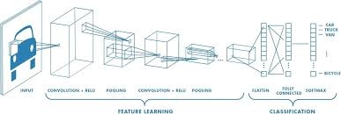
CNN Fundamentals
Core Concept
A Deep Learning architecture that uses Filters (Kernels) to automatically extract spatial or temporal patterns from data.
Key Points
Feature Learning: No manual feature engineering required; the model learns to identify 'malicious shapes' in traffic.
Notes:
Imagine a detective holding a small magnifying glass. Instead of looking at the whole crime scene at once, he slides the glass across the floor, inch by inch, looking for specific clues like a fingerprint or a shoe mark.

Slide 26
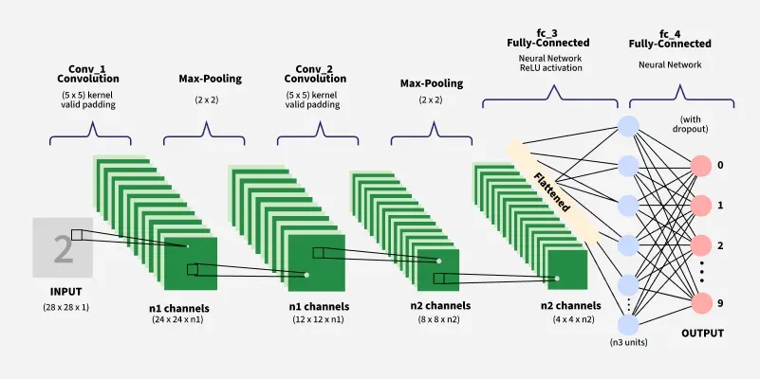
CNN
Notes:
This script explains how a Convolutional Neural Network (CNN)—famously used for image recognition—can be adapted for an Intrusion Detection System (IDS) by treating network features as a structured "image" of system behavior.
Presentation Script: CNNs – From Pixels to Packets
1. Introduction: Why Use a Vision Model for Security?
"We’ve looked at traditional models, but now we’re entering the realm of Deep Learning. This slide shows a Convolutional Neural Network (CNN). While CNNs are typically used for images (like identifying a '2' in the input), they are incredibly powerful for IDS because they excel at finding spatial patterns in data."
2. Translating IDS Features to a "Digital Image"
"You might ask: 'My system logs aren't pictures, so how does this work?' In a modern IDS, we take a sequence of network features—like bytes, duration, and protocol types—and arrange them into a 2D matrix.
Just as an image has pixels arranged in rows and columns, our IDS data becomes a 'snapshot' of network traffic over a short window of time.
The CNN then 'looks' at this snapshot to find suspicious shapes or patterns that represent an attack."
3. The Architecture: Step-by-Step
"Let's follow the data through the layers shown in the diagram:
Convolution Layers (Conv_1 & Conv_2): These layers use 'filters' (the $5 \times 5$ kernels) to slide across our data. They don't just look at one feature at a time; they look at relationships between neighboring features. For example, it might detect that a specific combination of small packet sizes followed by a rapid spike in CPU usage is a sign of a DDoS attack.
Max-Pooling: These layers (the $2 \times 2$ blocks) downsample the data. They keep only the most important 'signals' and discard the noise, making the model faster and more robust.
Flattening: Once the features are extracted, we 'flatten' them into a single long vector to prepare for the final decision-making phase."
4. The Final Decision: Fully Connected Layers
"The end of the pipeline consists of Fully Connected Layers (fc_3 & fc_4).
This is the 'brain' of the network. It takes all the patterns found by the convolution layers and maps them to a specific output.
In the image example, it outputs a digit from 0 to 9.
In our IDS, these output nodes would represent different classes: 'Normal,' 'Buffer Overflow,' 'Port Scan,' or 'Malware Communication.'"
5. Why This Matters for Security
"The beauty of using a CNN for IDS is its ability to handle high-dimensional data automatically. We don't have to manually tell the model which features are important; the convolution layers learn to 'see' the attack patterns themselves, even if they are buried in a complex sequence of normal traffic."

Slide 27
AI-Assisted Code Vulnerability Detection
Haowen Xu

Slide 28
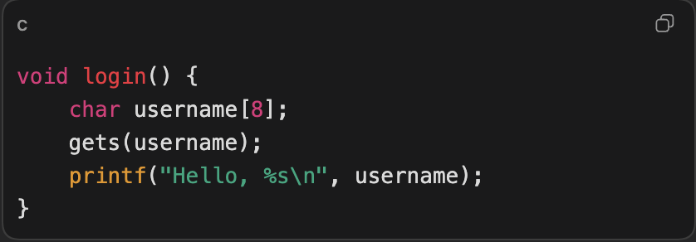
What are the Vulnerable Codes？
gets() does not check input length.
If the input is longer than the buffer, it can overwrite memory.
This is a classic example of unsafe memory handling in C.
Notes:
To make this more concrete, let me show simple examples of vulnerable codes. In this function, we define a fixed-size buffer called username, which can only hold 8 characters. However, the program uses gets() to read user input. The problem is that gets() does not check the input length. If the input is longer than the buffer, it will overflow and overwrite adjacent memory. This can lead to serious security issues, such as arbitrary code execution. This is a classic example of unsafe memory handling in C.

Slide 29
What are the Vulnerable Codes？
User input is directly concatenated into the SQL query.
An attacker may change the meaning of the query by injecting SQL syntax.
The safer approach is parameterized queries.
Notes:
In this case, the program constructs an SQL query by directly concatenating user input. The problem is that the user input is not sanitized or validated. This means an attacker can inject malicious SQL code to change the behavior of the query. For example, instead of a normal username, the attacker could input something like a crafted string that bypasses authentication. As a result, the database may return unintended data or grant unauthorized access. The safer approach is to use parameterized queries, which separate code from data and prevent injection attacks.

Slide 30
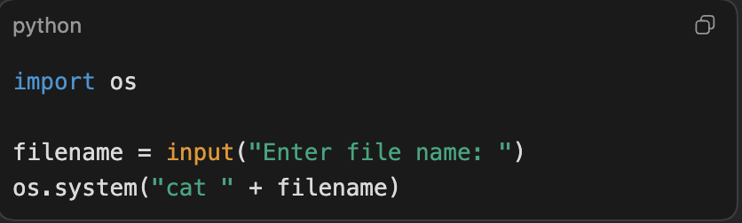
What are the Vulnerable Codes？
User input is inserted directly into a shell command.
If the input contains command separators or extra shell syntax, unintended commands may run.
This is an example of command injection risk.
Notes:
In this case, the program takes user input and directly inserts it into a shell command. Specifically, it constructs a command like cat <filename> and executes it using os.system(). The problem is that the input is not validated or sanitized. If an attacker provides input containing shell control characters, such as command separators, they can execute unintended commands. For example, instead of a filename, the attacker could inject additional commands that the system will execute. This is known as command injection, and it can lead to serious security issues such as unauthorized command execution.

Slide 31

Why do we need Vulnerability Detection
Software vulnerabilities are a major cause of security breaches
Manual code review is time-consuming and error-prone
Rule-based static analysis tools have limited coverage
New vulnerabilities appear faster than rules can be written
AI can help prioritize risky code for human review
Understand how AI detects code vulnerabilities
Run a vulnerability detection model
Analyze model predictions
Reflect on limitations of AI in security
Notes:
Let me start by explaining why vulnerability detection is important. Modern software systems are becoming increasingly complex and large-scale, and even experienced developers can unintentionally introduce vulnerabilities. As a result, software vulnerabilities remain a major cause of security breaches, such as data leaks, system compromise, and service disruption. Traditionally, detecting these vulnerabilities relies heavily on manual code review, which is both time-consuming and error-prone. Static analysis tools try to automate this process, but they mainly depend on manually crafted rules. These rules are hard to maintain and often fail to capture new or evolving vulnerability patterns. More importantly, new vulnerabilities appear much faster than these rules can keep up. This is where AI comes in. AI can automatically learn vulnerability patterns from large-scale code data. Instead of replacing human experts, it helps prioritize risky code regions and makes the review process more efficient.

Slide 32
Task Definition
Input: A function-level code representation
Output: Vulnerable (1) or Non-vulnerable (0)
Task Type: Binary classification
Granularity: Function-level vulnerability detection
Dataset: Real-World Vulnerability Data
Source: CVE-based, 150K+ C functions
Split: 5.8% vulnerable, 94.2% safe
Term | Meaning (Chinese) | What It Is | Example | Purpose
CVE ID | Vulnerability Identifier | A unique identifier for a specific vulnerability | CVE-2014-0160 | Track and reference a specific vulnerability
CWE ID | Vulnerability Type | A classification of vulnerability types | CWE-119 (Buffer Overflow) | Identify the category of a vulnerability
CVSS Score | Severity Score | A numerical score (0–10) indicating severity | 9.8 (Critical) | Prioritize vulnerability remediation
Commit Info | Commit Information | Git commit record that fixes the vulnerability | a3f5c8d… | Trace code changes across versions
Patch Details | Patch Details | Specific code modifications in the fix | strcpy → strncpy | Understand how the vulnerability was fixed
Notes:
We frame vulnerability detection as a supervised learning problem.
Each code function is treated as one data sample.
The model predicts whether this function contains a vulnerability or not.
So fundamentally, this is a binary classification task.
Our data comes from the MSR_data_cleaned dataset on HuggingFace, which is built from real-world CVE vulnerability records. It contains actual production code from well-known open-source projects like the Linux kernel, FFmpeg, and Apache.
In terms of scale, we have over 150,000 C language functions in total. Among these, 8,720 functions are vulnerable, accounting for 5.8%, while over 142,000 functions are non-vulnerable, making up 94.2%.
To better understand and label these vulnerable functions, real-world vulnerability records provide essential contextual information.
In vulnerability analysis, each vulnerability is described using standardized identifiers and metadata.
CVE IDs uniquely identify individual vulnerabilities, while CWE IDs categorize them based on underlying weakness types.
The CVSS score quantifies the severity of a vulnerability and helps prioritize remediation efforts.
In addition, commit information and patch details provide insight into how vulnerabilities are fixed at the code level.
Together, these elements form the foundation for understanding, analyzing, and automatically detecting software vulnerabilities using AI-based approaches.

Slide 33
Code Representation
How Is Code Converted into AI Input?
1. Tokenization
• Use C-Lexer to parse C code into tokens
• Remove comments & string literals
3. Sequence Encoding
• Token → Integer IDs
• Fixed length: 300 (padding/truncating)
• Embedding: ID → 128-dim dense vectors
2. Vocabulary Building
• 161,622 unique tokens
• Filter low-frequency tokens (min_freq=5)
4. Representation Level
• Function-level granularity
• Sequential structure preserved
Notes:
So how do we convert code into something AI can understand?
First, tokenization. We use a C lexer to break down the source code into tokens—things like keywords, operators, and variable names. We also preprocess the code by removing comments and string literals, since they don't affect functionality. For example, a function like 'strcpy(buffer, input)' becomes a sequence of tokens: 'strcpy', opening parenthesis, 'buffer', comma, 'input', closing parenthesis.
Second, vocabulary building. Across all 150,000 functions, we identified over 161,000 unique tokens. To reduce noise, we filtered out tokens that appear fewer than 5 times.
Third, encoding. Each token is converted to an integer ID. Then we standardize the sequence length to 300 tokens—longer functions are truncated, shorter ones are padded with zeros.
Finally, embedding. These integer IDs are transformed into 128-dimensional dense vectors through an embedding layer. This captures semantic relationships between tokens—similar code patterns get similar vector representations.
The key point is: we preserve the sequential structure of the code while converting it into a numerical format the neural network can process."

Slide 34
Model Architecture
3. Why Attention? ⭐
• Not all code tokens are equally important
• Focus on vulnerability-critical patterns
• Automatically weight relevant tokens
1. Why Sequence Models?
• Code has syntactic order (like natural language)
• Dependencies between statements
• Vulnerability patterns span multiple lines
2. Why Bi-LSTM?
• Forward pass: understand what comes before
• Backward pass: understand what comes after
• Example: Variable usage requires definition & usage context
4. NLP Analogy
• Code = Structured language
• Tokens = Words
• Functions = Sentences/Paragraphs
Notes:
"Our model is a Bi-LSTM with attention. Let me explain why.
Bi-LSTM: We read code in both directions—forward and backward—because vulnerabilities depend on context from both sides. For example, understanding a pointer requires knowing where it's allocated AND where it's freed.
Attention mechanism: Not all code is equally important. Some keywords like 'strcpy' are high-risk, while others like semicolons don't matter much. Attention automatically learns to focus on the critical parts—the vulnerability hotspots.
The architecture is: embedding layer, bidirectional LSTM, attention, dense layer with dropout, and sigmoid output for binary classification.
It's like teaching the model to review code the way a security expert would—scanning both ways and focusing on the dangerous patterns."

Slide 35
Hands-on Task
Task 1: Explore the Dataset
Task 2: Train the Model
Task 3: Make Predictions
Task 1: Explore the Dataset
Inspect input features
Understand labels
Observe data imbalance
Task 2: Train the Model
Run training cells
Observe loss and accuracy
Compare train vs validation
Task 3: Make Predictions
Test on unseen samples

Slide 36
AI-Assisted Binary & Library Fuzzing
Notes:
"So far, we have talked about Static Analysis—which is like a detective carefully reading through a suspect's diary without ever meeting them. It’s great for finding obvious mistakes in the code, but it has a limit: it can't tell you exactly what happens when the program actually runs in the real world."
Introducing Fuzzing (The "Crash Test")
"This brings us to Fuzzing, or Fuzz Testing. If Static Analysis is 'reading,' Fuzzing is 'Stress Testing.' Think of it like a Digital Crash Test. Instead of reading the car's blueprints, we actually build the car and throw thousands of random, weird, and 'malformed' objects at it—like oversized luggage or strange fuel—to see if we can make the engine explode or the doors fall off."

Slide 37
Content
How C & C++ code works during execution
Why dynamic detection method as fuzzing matters
How LLMs helps fuzzing
Hands on experiments
Notes:
.
Here is the outline of today’s talk.
First, I’ll briefly explain how C and C++ programs execute, because this directly affects how fuzzing works.
Then I’ll explain why dynamic detection methods, especially fuzzing, are necessary compared to static analysis.
After that, I’ll introduce how large language models can help fuzzing, especially in generating and mutating inputs.
Finally, I’ll show some hands-on experimental results, including coverage improvements on real-world OSS-Fuzz projects.

Slide 38
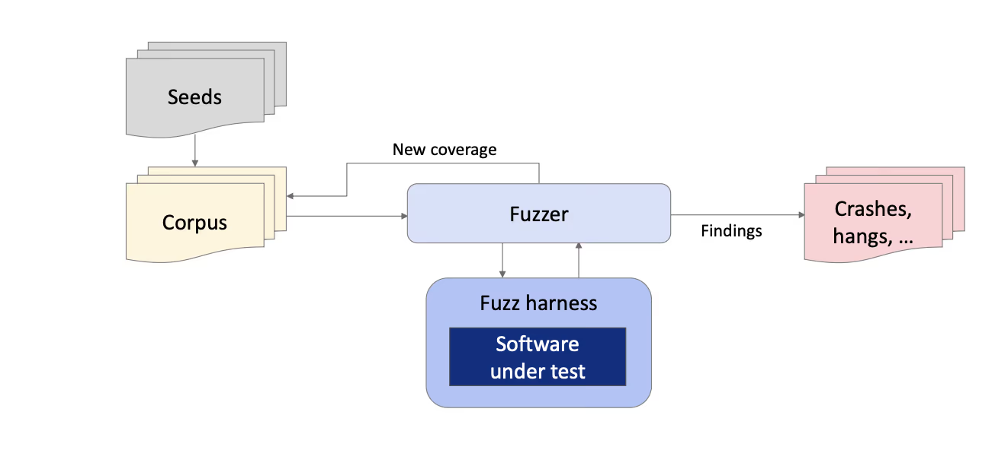
How code works during execution
Fuzzing Workflow Overview
Seeds provide initial valid or semi-valid inputs
→ Serve as starting points for fuzzing
Corpus stores inputs that trigger new behaviors
→ Continuously updated based on coverage feedback
Fuzzer mutates inputs and schedules executions
→ Guided by coverage and runtime feedback
Fuzz Harness connects the fuzzer to the software under test
→ Feeds inputs and observes execution behavior
Findings include crashes, hangs, and abnormal behaviors
→ Indicate potential bugs or vulnerabilities
Notes:
This diagram illustrates the core feedback-driven loop of modern fuzzing.
The process starts with a set of seed inputs, which are typically valid or representative examples of the program’s expected input format. These seeds are placed into a corpus, which acts as the evolving knowledge base of the fuzzer.
The fuzzer repeatedly selects inputs from the corpus and applies various mutation strategies to generate new test cases. Each mutated input is then passed through the fuzz harness, which serves as a wrapper that feeds the input into the software under test and executes the target code in a controlled manner.
During execution, the fuzzer monitors runtime feedback, most importantly code coverage information. If a new input triggers previously unseen execution paths, it is considered valuable and added back into the corpus, enabling the fuzzer to progressively explore deeper and more complex program behaviors.
At the same time, the fuzzer records findings such as crashes, hangs, or memory violations. These findings often correspond to real bugs or security vulnerabilities, making fuzzing an effective dynamic analysis technique for discovering flaws that are difficult to detect with static methods.

Slide 39
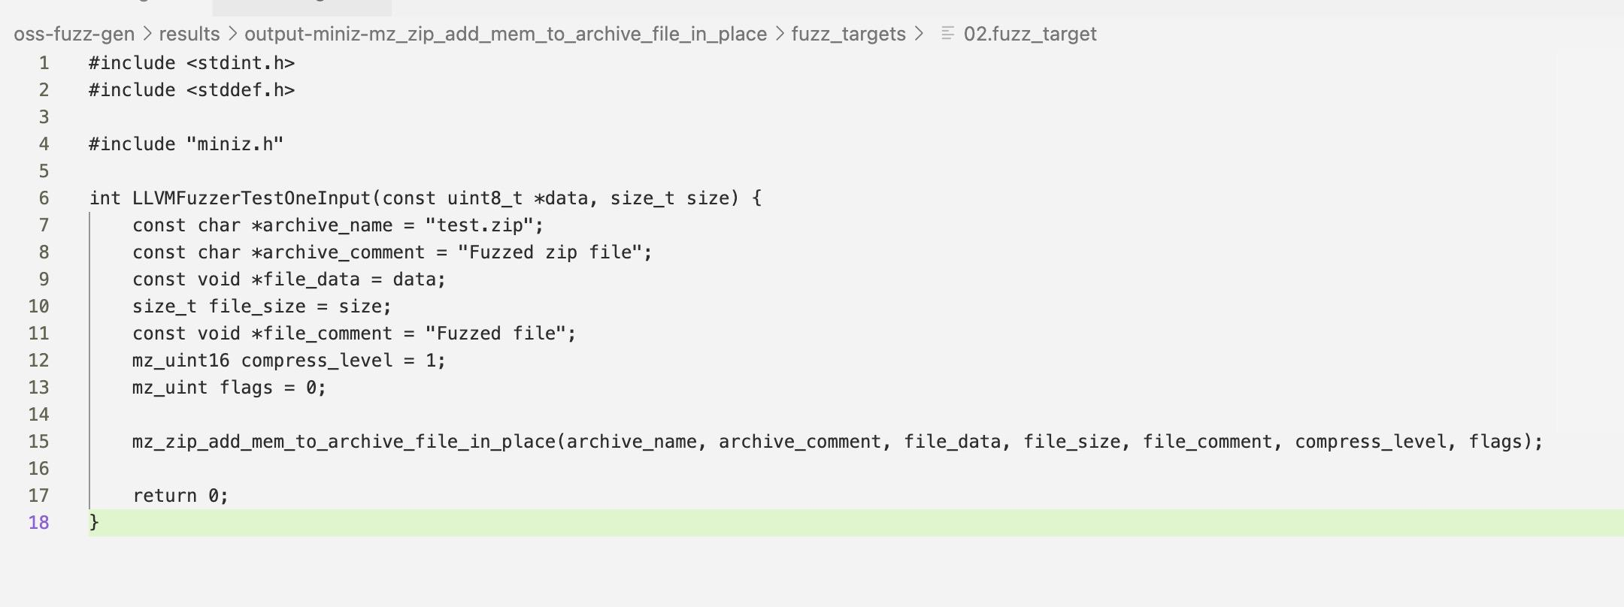
How code works during execution
Given an input (from stdin or harness files)
A harness defines the entry point for the fuzzer
It maps raw fuzzer input to meaningful program inputs
→ data and size are interpreted as file contents
It invokes a specific target API or function
→ mz_zip_add_mem_to_archive_file_in_place(...)
It isolates the test logic from the rest of the application
→ No CLI parsing, no full program execution
Notes:
This code snippet is a typical example of a fuzz harness file used by modern fuzzers such as LibFuzzer or OSS-Fuzz.
The harness defines a special function, LLVMFuzzerTestOneInput, which serves as the entry point that the fuzzer repeatedly calls with mutated inputs.
The parameters data and size represent the raw bytes generated by the fuzzer. The role of the harness is to translate these arbitrary bytes into inputs that the target software can consume. In this example, the fuzzed data is treated as in-memory file content and passed directly to a ZIP-processing API in the miniz library.
Rather than fuzzing an entire application or command-line tool, the harness directly invokes a specific function of interest—mz_zip_add_mem_to_archive_file_in_place. This allows the fuzzer to focus on a well-defined execution path and efficiently explore edge cases inside the library code.
By isolating the target functionality and eliminating unrelated logic such as argument parsing or I/O handling, the harness improves coverage, performance, and crash reproducibility. In practice, the quality of the harness largely determines how effective fuzzing will be at uncovering deep bugs and security vulnerabilities.

Slide 40
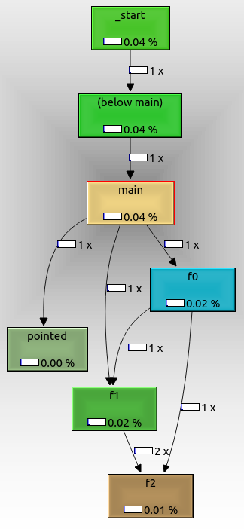
How code works during execution
Given an input (from stdin or harness files)
Run ONE path from main() to somewhere
-- call graph
Nodes represent functions
→ _start, main, f0, f1, f2
Edges represent function calls
→ An edge means “this function may call that function”
Edge labels show call frequency
→ 1×, 2× indicate how many times the call happened
Coverage/color reflects execution frequency or time
→ Helps identify hot and cold functions
Notes:
This diagram is a call graph, which describes how functions call each other during program execution.
Each node represents a function, and each directed edge indicates a possible or observed function call relationship.
Execution starts from the program entry point (_start), flows into main, and then branches into other functions such as f0 and f1. Some functions, like f2, may be called from multiple callers, which is why multiple arrows converge on them.
The numbers on the edges indicate how many times a call occurred, while the colors or percentages show relative execution cost or coverage. Call graphs are useful for understanding high-level program structure, but they do not show what happens inside a function.

Slide 41
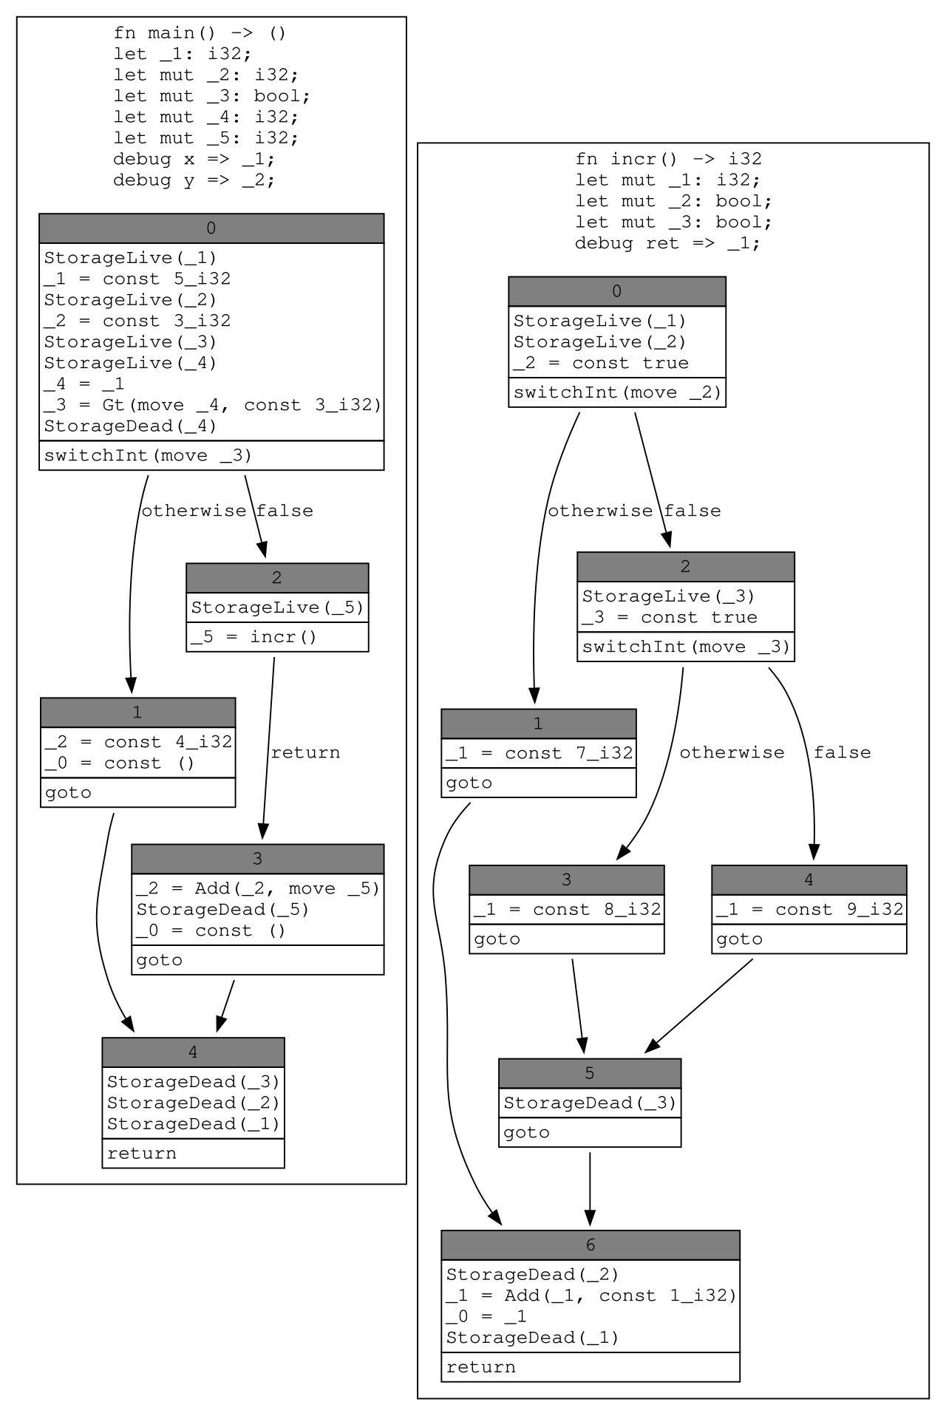
How code works during execution
Given an input (from stdin or harness files)
Run ONE path from main() to somewhere
-- control flow graph
A CFG models execution flow inside a single function
Nodes are Basic Blocks (BBs)
→ Straight-line code with one entry and one exit
Edges represent possible control transfers
→ if, else, switch, goto, return
Branching splits execution into multiple paths
→ Only one path is taken per execution
Notes:
“Now we stop looking at which functions call which.
Instead, we focus on what happens inside a single function, step by step.”
1️⃣ What does a CFG describe?
A Control Flow Graph shows all the possible ways execution can flow inside one function.
In simple terms, it answers the question:
“If the program is at this line, where can it go next?”
The CFG draws all those possible next steps.
2️⃣ What is a Basic Block?
“Each box in the CFG is called a Basic Block.”
A Basic Block is a chunk of code that:
Executes straight from top to bottom
Has no jumps in the middle
Has one entry point
Has one exit point
Once execution enters a basic block, every instruction in it will run.
So remember this:
A Basic Block is a piece of code that always executes together.
3️⃣ Why do we split code into Basic Blocks?
Because real programs contain:
if / else
switch
goto
return
Whenever the program needs to make a decision, the execution can split.
At that point, the CFG cuts the code into separate basic blocks.
Each block represents one uninterrupted execution segment.
4️⃣ What do the arrows mean?
The arrows show where execution may go next after finishing a block.
Conditional statements create multiple outgoing arrows
A goto creates a single forced jump
A return ends the function and has no outgoing arrow
Important point:
The CFG shows all possible paths — not one actual run.
5️⃣ How many paths does one execution take?
Only one.
Even though the CFG looks like a network of many paths,
a single program run follows only one path from start to end.
A good analogy is:
“The CFG is a map.
A program execution is one route on that map.”
6️⃣ Why is CFG important for fuzzing?
This explains a key idea in fuzzing:
One fuzz input
Executes one path in the CFG
Other paths require different inputs
So fuzzing works by:
Generating many inputs to explore new paths in the CFG.
Bugs often hide in paths that are rarely taken.

Slide 42
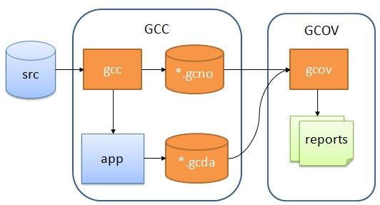
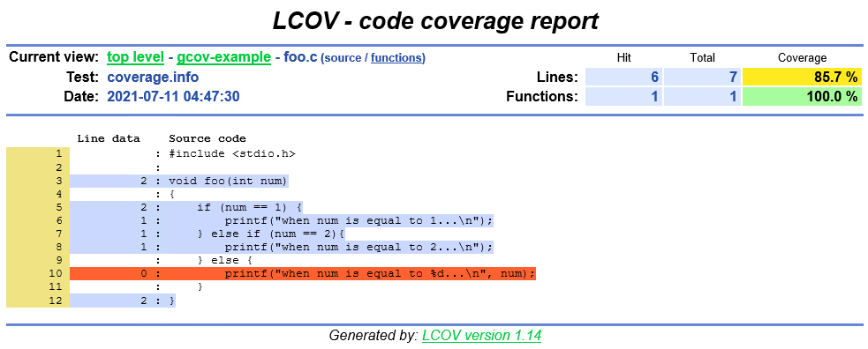
Why dynamic detection method as fuzzing matters
Code coverage
Source code is compiled with coverage instrumentation
→ GCC inserts counters into the program
Compilation produces a static structure file (.gcno)
→ Describes the program’s control-flow structure
Program execution produces runtime data (.gcda)
→ Records which parts of the code actually ran
gcov processes both files to generate coverage data
→ Used to build human-readable reports
Notes:
When we compile a program with GCC using coverage flags, the compiler does not just produce a normal binary.
It instruments the code by inserting counters at important locations, such as basic blocks and branches.
During compilation, GCC generates a file called .gcno.
This file contains the static structure of the program — essentially, where the code could go.
When we run the program, the instrumented binary produces a .gcda file.
This file records what actually happened at runtime — which lines or blocks were executed, and how many times.
Finally, the gcov tool combines the static structure (.gcno) with the runtime data (.gcda) and turns it into coverage information that other tools can visualize. This LCOV report shows which lines of code were executed during the test run.
Each line in the source code is annotated with a number:
A positive number means the line was executed that many times
A zero means the line was never executed
Colors make this very intuitive:
Blue or green lines were covered
Red lines were never reached
At the top, LCOV summarizes coverage using percentages:
Line coverage: how many lines were executed
Function coverage: how many functions were entered
In this example, one branch of the if–else statement was never taken, which means the program logic is only partially tested.

Slide 43
Why dynamic detection method as fuzzing matters
Code coverage
Seed
-- a file (json, xml, ...)
-- a string
-- a number
-- sometimes non-readable
Notes:
.
Fuzzing starts from seeds.
A seed is simply an input to the program. It can be a file like JSON or XML, a string, a number, or sometimes even a binary blob that is not human-readable.
The quality of these seeds matters a lot, because they determine which execution paths we can reach initially.

Slide 44
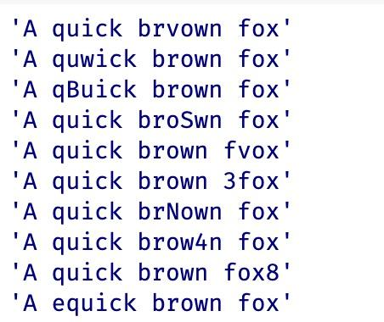
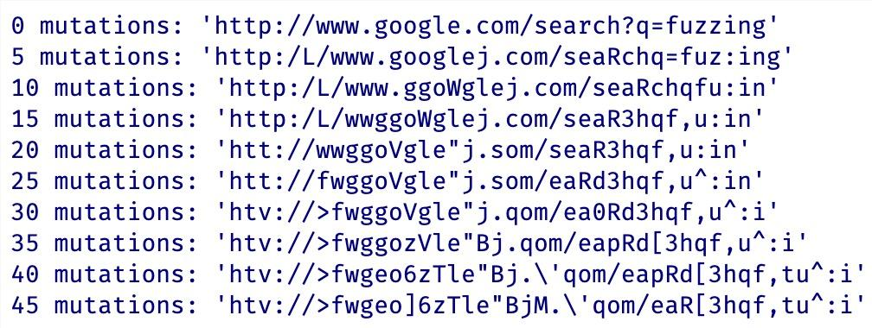
Why dynamic detection method as fuzzing matters
Code coverage
Seed
Scheduling(mutation)
-- byte level
-- token level
-- structure level
-- gramar based
-- semantic mutation
Notes:
.
After we have seeds, fuzzing relies on mutation strategies.
Traditional fuzzers mutate inputs at the byte level, such as flipping bits or bytes.
More advanced fuzzers use token-level or structure-level mutations, and grammar-based fuzzers ensure syntactic validity.
Recently, there is increasing interest in semantic mutation, where we try to change the meaning of the input rather than just its bytes.
This is where LLMs become particularly useful.

Slide 45
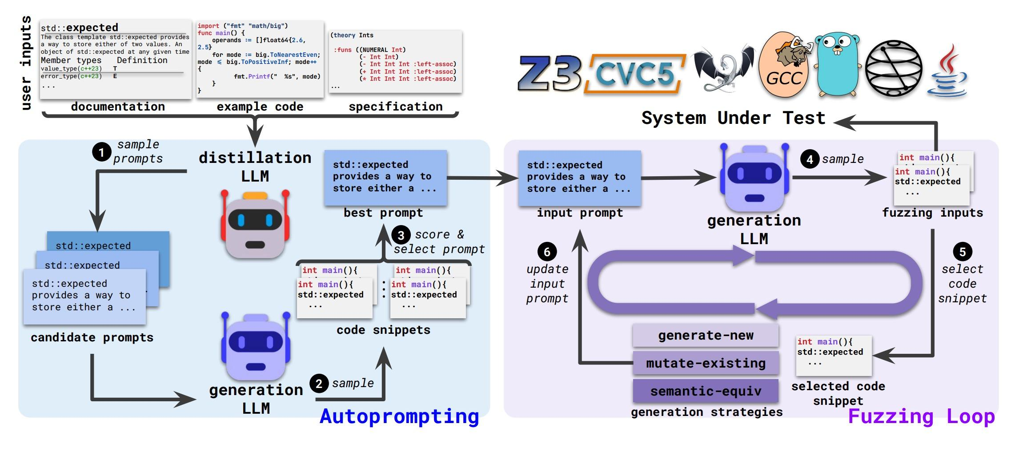
How LLMs helps fuzzing
Notes:
Figure Description: LLM-Driven Autoprompting and Fuzzing Pipeline
This figure presents an end-to-end framework that combines LLM-based autoprompting with a semantic fuzzing loop to test complex software systems, such as compilers, interpreters, and formal verification tools.
At the top of the pipeline, the framework takes heterogeneous user-provided knowledge as input, including documentation (for example, API descriptions of std::expected), example code snippets, and formal specifications. Together, these sources define the semantic scope of the target functionality and serve as the foundation for constructing effective prompts.
The left side of the figure illustrates the autoprompting via distillation process. In this stage, the system samples multiple candidate prompts derived from the available documentation, examples, and specifications. A generation LLM then uses these prompts to produce multiple candidate code snippets, such as small C++ programs exercising the target feature. These generated snippets are evaluated according to criteria such as correctness, diversity, or downstream performance. Based on this evaluation, the system selects the best-performing prompt, effectively distilling a refined input prompt that captures the intended semantics of the target functionality.
The right side of the figure shows a semantic fuzzing loop guided by an LLM and feedback from the system under test (SUT). The refined prompt is fed into a generation LLM, which produces fuzzing inputs in the form of code snippets. A subset of these generated snippets is selected and executed against the SUT, which may include SMT solvers (e.g., Z3 or CVC5), compilers (e.g., GCC), or language runtimes and analysis tools. During execution, results such as failures, crashes, or coverage information are collected and used as feedback. This feedback is then used to update the input prompt, and the process iterates.
Within the fuzzing loop, the framework supports multiple generation strategies. These include generating entirely new programs, mutating existing generated code, and applying semantic-equivalent transformations that produce syntactically different but semantically equivalent inputs. By operating at the semantic level rather than relying solely on low-level syntax mutations, these strategies enable more effective exploration of the input space.
Overall, the figure highlights a closed-loop, LLM-assisted testing framework that automatically distills high-quality prompts from raw knowledge sources, leverages semantic code generation to drive fuzzing, and continuously improves input quality through execution feedback. This design enables semantics-aware fuzzing that goes beyond random mutations and is particularly well suited for testing complex, specification-heavy systems.

Slide 46
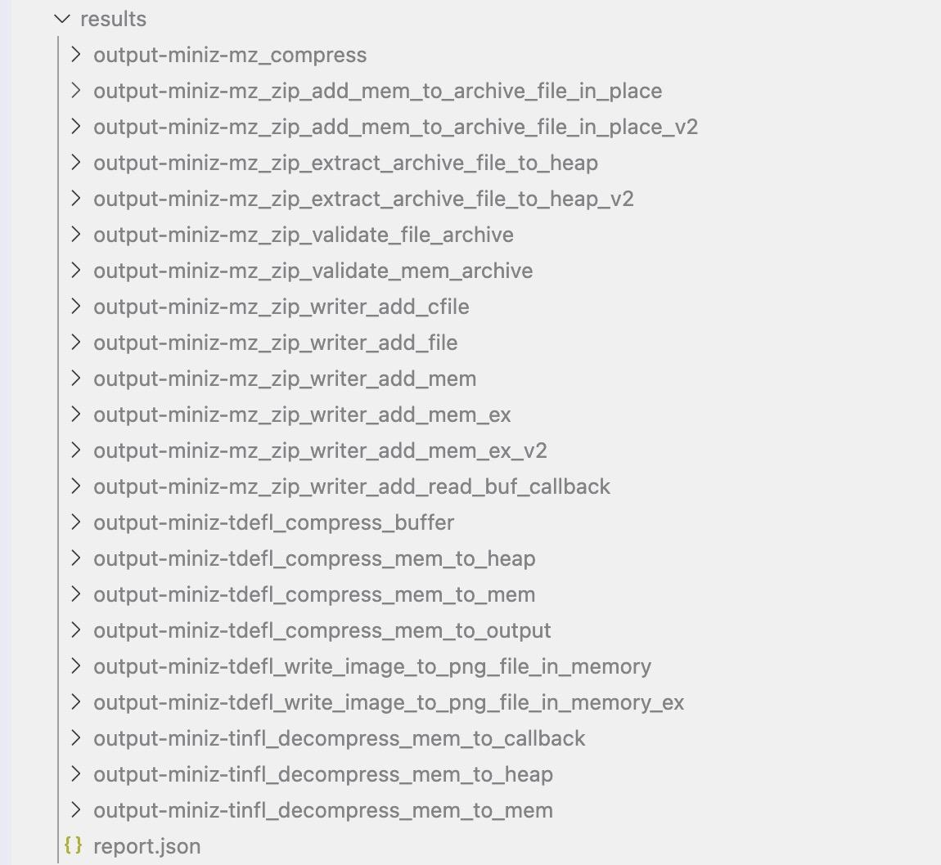
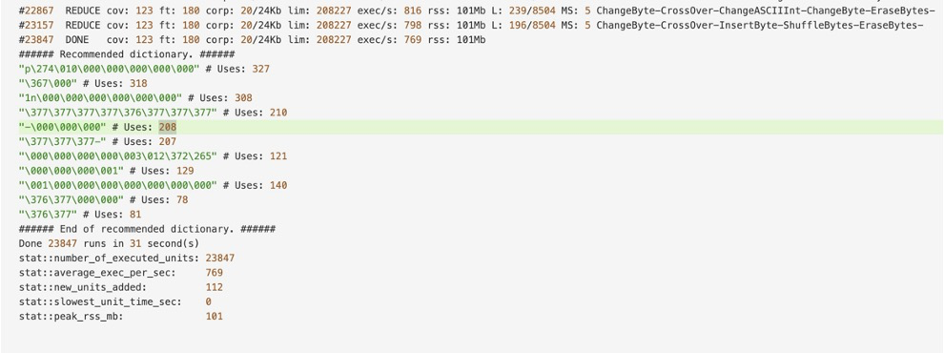
Hands on experiments
OSS-Fuzz-gen
Notes:
.
To evaluate these ideas, we conducted experiments on OSS-Fuzz, which is Google’s large-scale continuous fuzzing infrastructure for open-source software.
We compare the traditional OSS-Fuzz setup with OSS-Fuzz-Gen, which uses LLM-generated fuzzing harnesses and inputs.
This allows us to measure whether LLM assistance can actually improve coverage on real-world projects.

Slide 47

Post-workshop Quiz
https://docs.google.com/forms/d/e/1FAIpQLSeWm6VmdRqP1jc2hU-sAQfu6CTMRnFNIZcRbN3DBW2gzjh0ZA/viewform?usp=publish-editor

Slide 48

Post-workshop Survey
https://docs.google.com/forms/d/e/1FAIpQLSfLsSk2Im3z0i-C1vZZvoncM_lZDDe_UpqJ85Q3chkUuPl4Hg/viewform

Slide 49
Thanks
Q&A
Notes:
To conclude, fuzzing is fundamentally about exploring program behaviors, and dynamic execution is essential for that.
Large language models provide a new way to guide this exploration by generating and mutating inputs at the semantic level.
Our experiments show that this approach can lead to meaningful coverage improvements on real-world codebases.
Thank you for your attention. I’m happy to take any questions.

